Slide 1

Technical Report

Slide 2
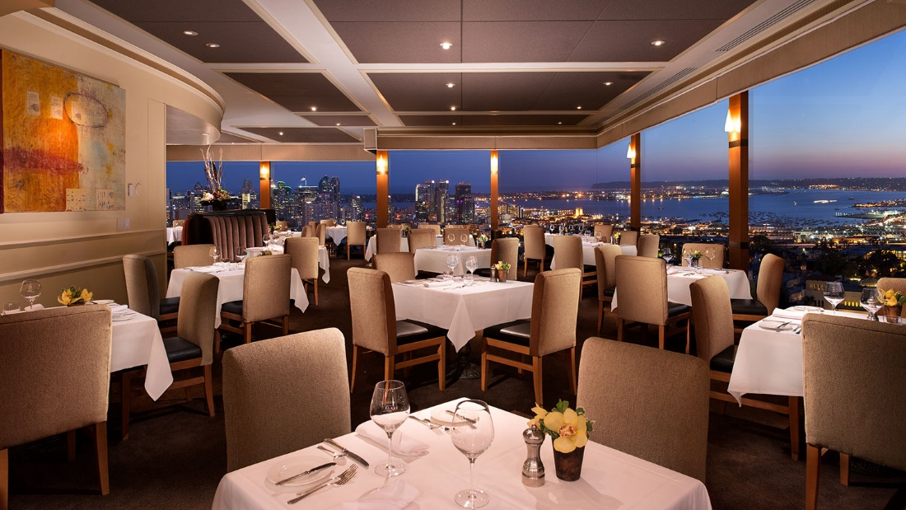
Project Overview
The restaurant has so far shown very good progress
Management successfully tackled previous challenges including employee’s performance, creating a good working environment, capital requirements, and point of sale management.
The management is now only concerned with the prospects of the company.

Slide 3
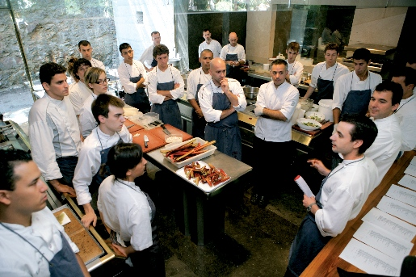
Project Goals
The management is now the placing emphasis on the business continuity of the restaurant
To ensure Stabilized growth and future profitability and adaptability of the restaurant

Slide 4
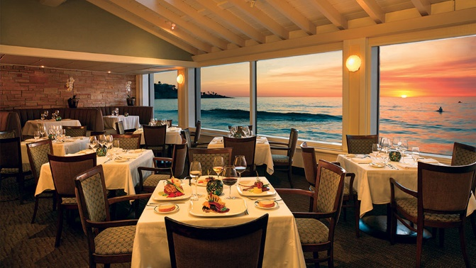
Project Approach
Formation of stable and long-term partnerships with business distribution channels, suppliers and corporate consumers.
Source more investors into the restaurant growth as its strategies to expand.
The management objects to make international market entry.
Diversifying its services including catering services, lodging services, and a tour company services.

Slide 5

Expected results
The resultant sales are expected to increase and stabilize.
Restaurant is expected to have opened 20 outlets and branches within five years.
Enter the international market after seven years of the operation.

Slide 6

Resources
Capital is sourced form investors.
management will, therefore, look to raise not less than $1,000,000.
Capital generated from sales will also be used to fund this business strategy.

Slide 7

Assumption
There will be no catastrophic event in the future that may lead to the closure of the restaurant including hostile weather events or economic downturns.
There will e positive response form investors.

Slide 8

Milestone
Opening Twenty branches in five years time.
Entering the international market in seven years of operation.

Slide 9
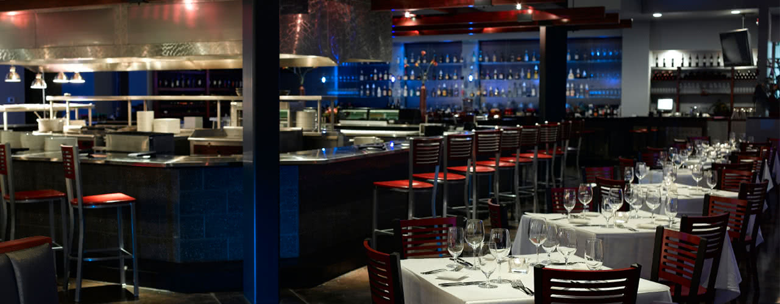
Limits and Exclusions
Restaurant is new and will, therefore, expect tough competition in the restaurant market
Insufficient capital to expand will also see that the expansion is delayed.

Slide 10
Reference
Walker, J. R. (2013). The restaurant: from concept to operation. Wiley Global Education.
Han, H., & Hyun, S. S. (2017). Impact of hotel-restaurant image and quality of physical-environment, service, and food on satisfaction and intention. International Journal of Hospitality Management, 63, 82-92.
Giousmpasoglou, C. (2016). Hotel and restaurant management education.
Zheng, C., & Forgacs, G. (2017). The emerging trend of hotel total revenue management. Journal of Revenue and Pricing Management, 16(3), 238-245.
Ruiz-Molina, M. E., Gil-Saura, I., & Berenguer-Contrí, G. (2014). Information and communication technology as a differentiation tool in restaurants. Journal of Foodservice Business Research, 17(5), 410-428.
Silva, J. (2017). U.S. Patent No. 9,805,401. Washington, DC: U.S. Patent and Trademark Office.

